Slide 1
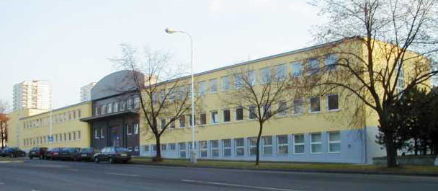
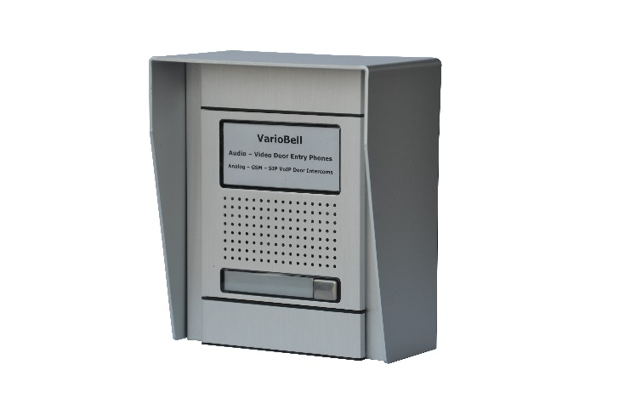
ALPHATECH TECHNOLOGIES s.r.o.
DOOR ENTRY - DOOR INTERCOM SOLUTIONS
A-VarioBell Door Entry Phone
Part of VarioBell family – analog, GSM and SIP VoIP audio – video systems
www.alphatechtechnologies.cz
Made in Czech Republic, EU

Slide 2
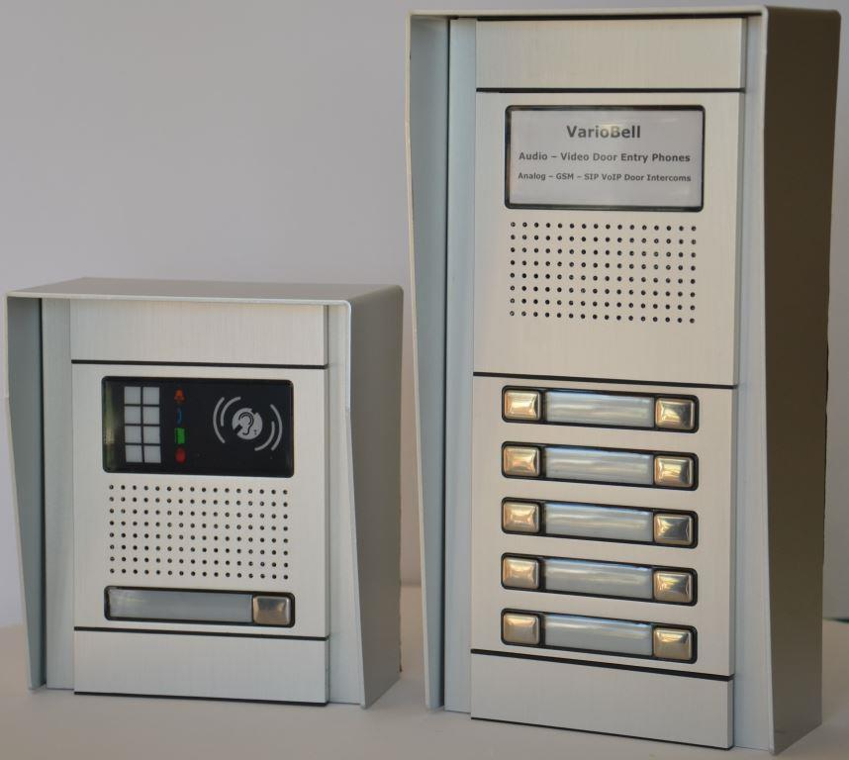
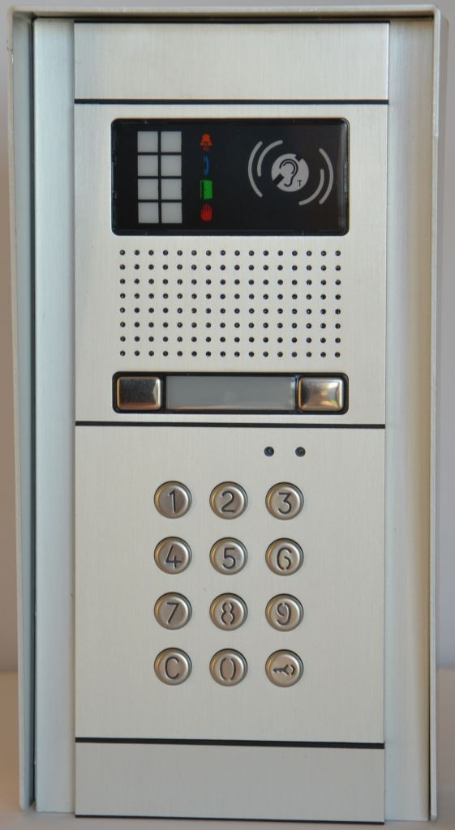
A-VarioBell analogue door entry phone
A-VarioBell Door Entry Phone system
Flexible analog door intercom
Member of VarioBell family – choose analog, GSM or SIP VoIP solution according to your requirements

Slide 3
A-VarioBell analogue door entry phone
A-VarioBell Door Entry Phone system
Flexible analog door intercom
Variety of choice – from 1 up to 87 call buttons, keypad and more

Slide 4
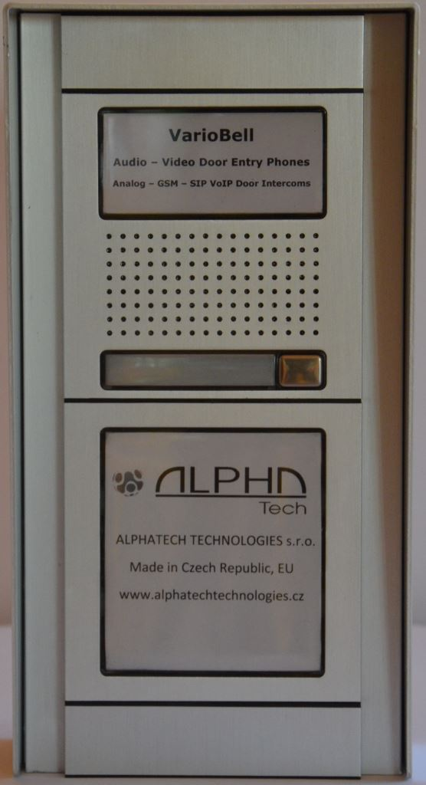
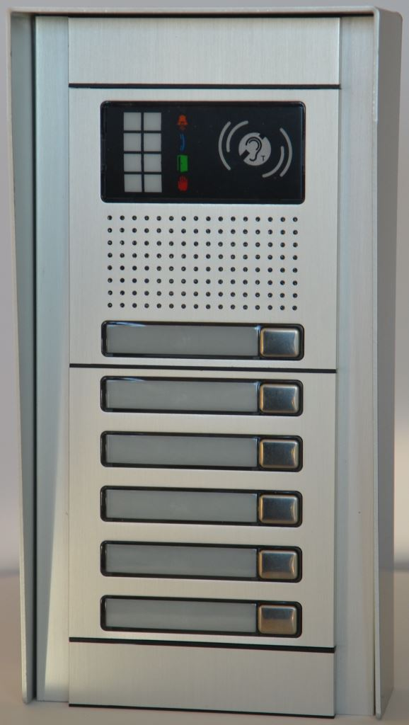
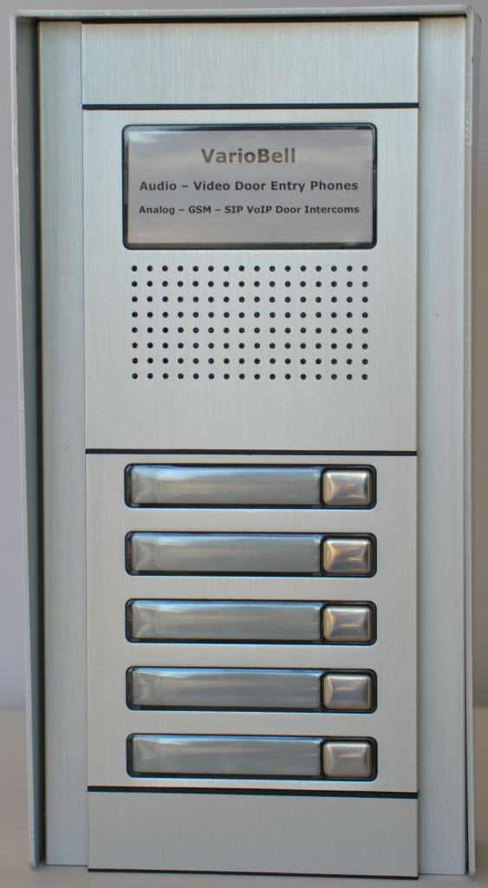
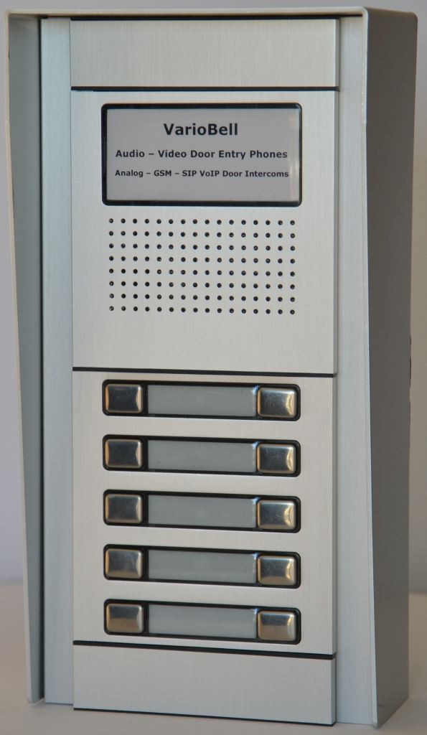
A-VarioBell analogue door entry phone
A-VarioBell Door Entry Phone system
Flexible analog door intercom – choose your preferred configuration

Slide 5
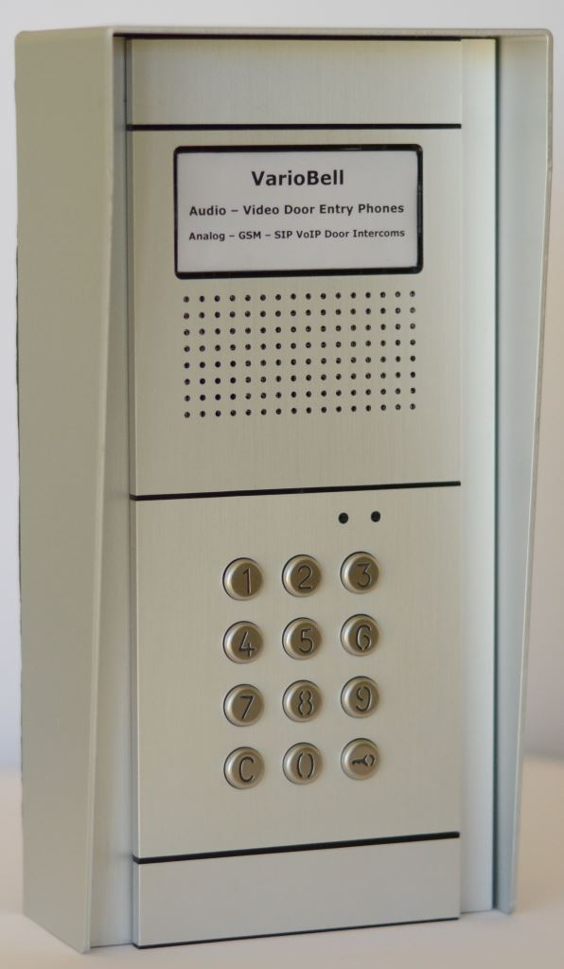
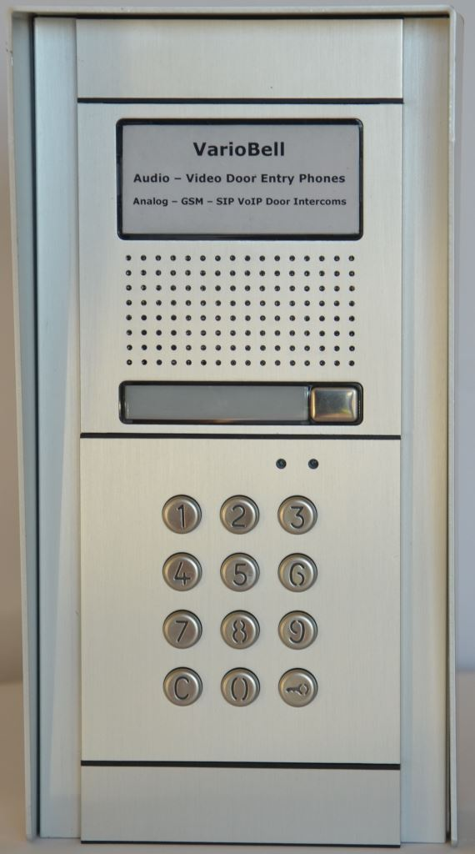
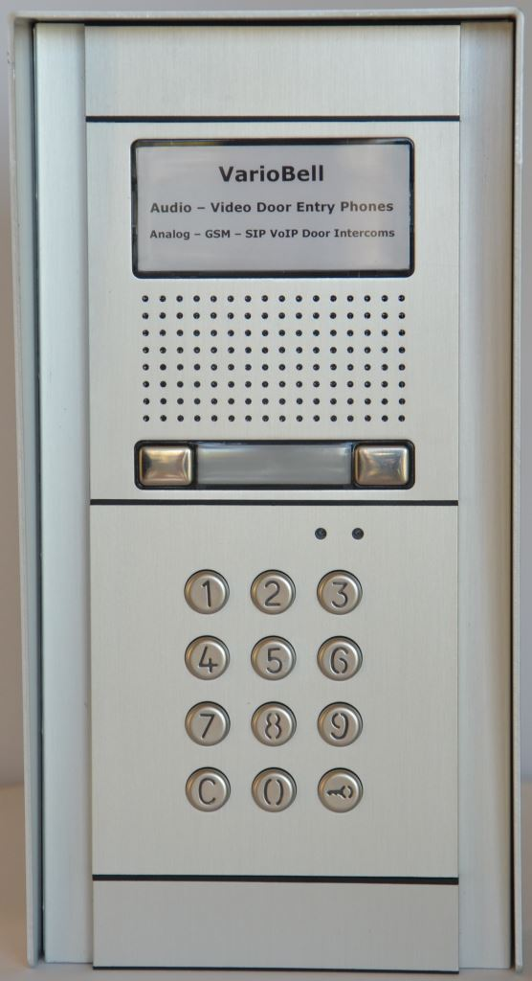
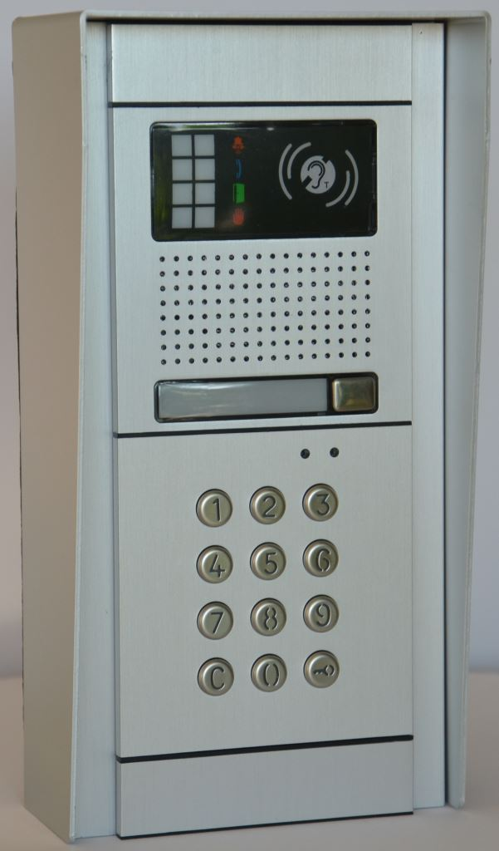
A-VarioBell analogue door entry phone
A-VarioBell Door Entry Phone system
Flexible analog door intercom – use keypad both for dialling call numbers and access control

Slide 6
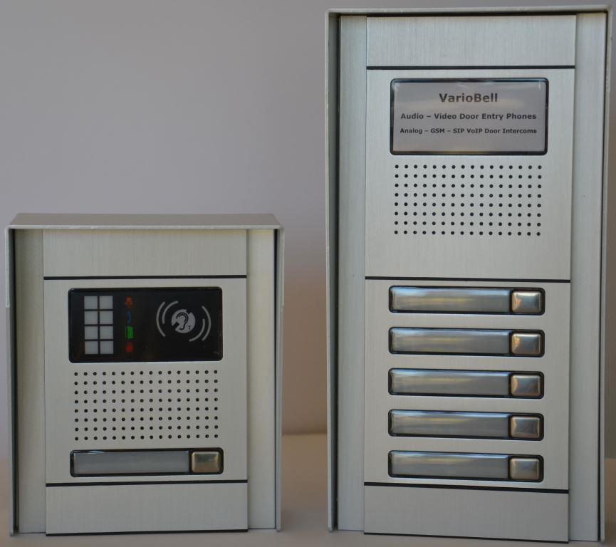
A-VarioBell analogue door entry phone
A-VarioBell Door Entry Phone system
Flexible analog door intercom – use call buttons both for calling users and for access control

Slide 7
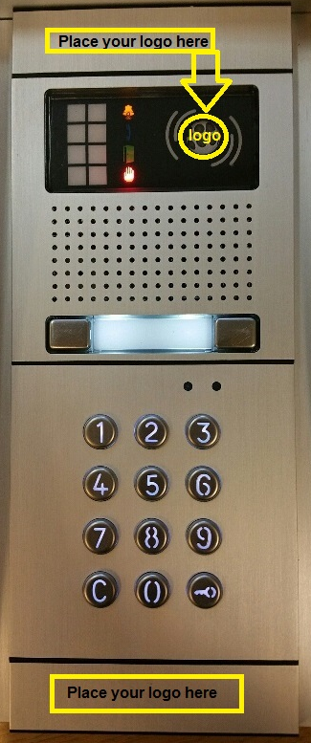
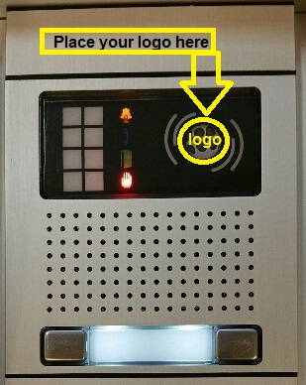
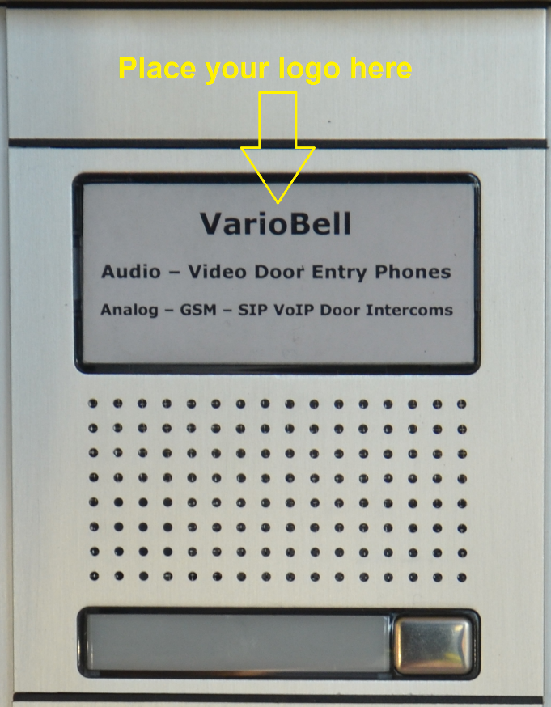
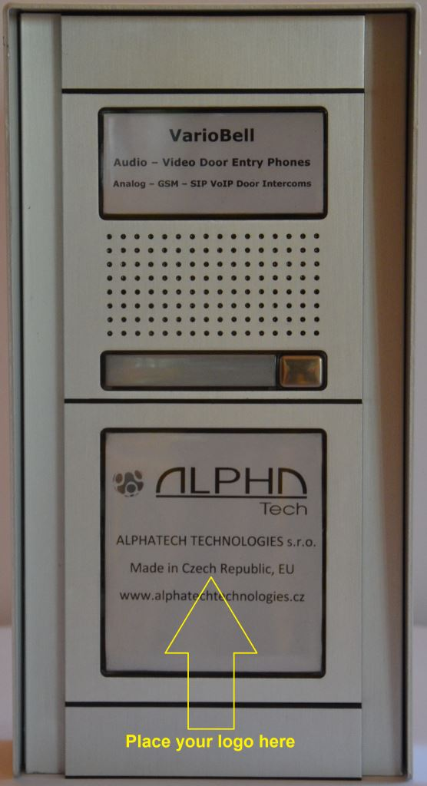
A-VarioBell analogue door entry phone
A-VarioBell Door Entry Phone system
Flexible analog door intercom - OEM ready for your own projects

Slide 8
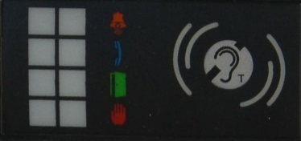
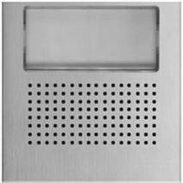
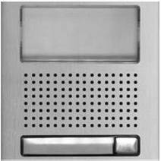
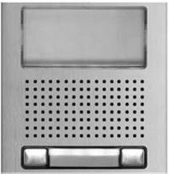
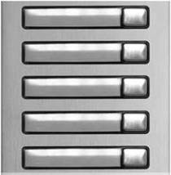
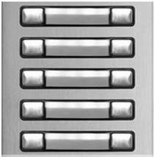
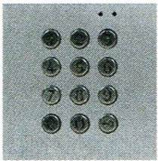
A-VarioBell analogue door entry phone
Modular, therefore ready for your variable needs
1 to 87 call buttons
First 10 call buttons can be used for entering door access code
Numerical dialling/access code keypad, keypad does not limit number of call buttons
Up to 99 users via speed-dial 2-digit numbers stored in memory
Up to maximum capacity of phone system (PBX) by dialling extension numbers
From 10 up to 36 access codes depending on settings
Main modules with info window or window with status LEDs
Hearing impaired friendly system – optional audio-induction loop for speaker

Slide 9
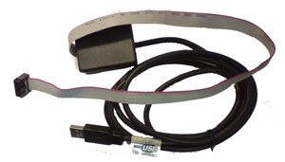
A-VarioBell analogue door entry phone
Analogue, therefore fully compatible system
Connection via analogue line, PSTN, land line
Powered from analogue line only
Compatible with any telephone system (PBX) with analogue ports
Easy remote programming via DTMF or locally via PC or DTMF
Universal call button and keypad modules for analogue, GSM and SIP VoIP VarioBell doorphones
PC USB
cable

Slide 10
A-VarioBell analogue door entry phone
Remotely accessible, therefore easy to control system
Remote opening of door / gate
Activate the relay contacts via DTMF
From your analogue desk phone (extension line of PBX)
From your mobile phone

Slide 11
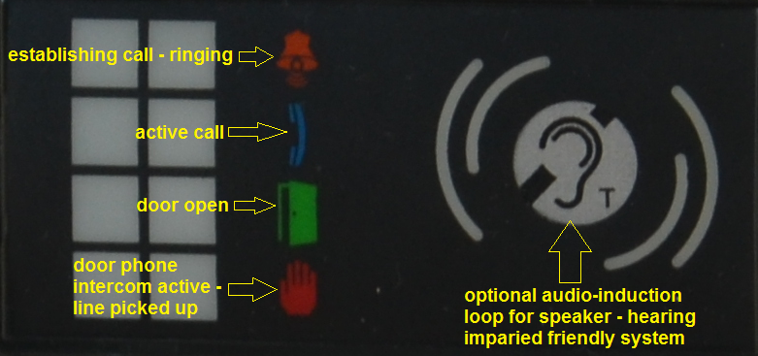
A-VarioBell analogue door entry phone
1. ringing
2. active call
3. door open
1.
2.
0. doorphone is active
LEDs label
Part of each main module
Acoustic sound signallization of status
Analog by beeping sounds
Optionally for projects by voice messages
Optional add-on voice module required
GSM by voice messages
IP by voice messages
LEDs label with optional hearing impaired loop
Status LEDs window – call in progress (ringing), call active, door open, doorphone active (line is picked up)
Hearing impaired friendly system – optional audio-induction loop for speaker
3.
0.

Slide 12
A-VarioBell analogue door entry phone
Acoustic signallization
Status Play Tone | Tones | Tone frequency
Pick up line type 1 | –▄■▄■▀– | 980-1333-1650
Disconnection of line type 1 (hang up type 1) | –▀■▄■▄– | 1650-1333-980
Pick up line type 2 | –▄■▀– | 800-1067-1200-1333
Disconnection of line type 2 (hang up type 2) | –▀■▄– | 1333-1200-1067-800
Confirmation of command from the phone | ––█–– | 800
Ticking during a call | ─┴─┴─
Notice about the end of a call | –■–■–■– | 1333
Relay switch signal | ─▒▒▒▒▒▒─ | Modulated
Entry into programming from the phone | –▄■▀– | 980-1067-1180
Programming from the phone | ––▓–▓––––– | Modulated
Parameter confirmation | ––█–– | 800
Entry into programming from the PC | –▄■▀– | 980-1067-1180
Line connection (Reset) | –■–▄–■– | 1850-1067-1850
Error (generally something is not right) | –■–■–■–■–■–■– | 800
Empty memory (no number is programmed) | –▄■▄■▄■▄■– | 1300-2100
Acoustic signallization of status
by beeping sounds
sounds can be turned off in several levels
Optionally for projects only
signallization by voice messages
optional add-on voice module required

Slide 13
A-VarioBell analogue door entry phone
A-VarioBell modules
N1000/AL AUDIO Analog
Ordering code: 11881000A
Module external dimensions: 100(w) x 100(h) mm
Analogue main module, audio with MIC and SPK, 0 buttons, small info window / status LEDs window
1.8mm thick alluminium, info window made of polycarbonate. Call button with stainless steel cover
Powered from analogue line only or if powered from an external power supply 12VAC / 12VDC, status LEDs indicate actual state of doorphone
User can decide if he wants to use info window (e.g. house number or company name label) or status LEDs window. Four colour LEDs (yellow, blue, green and red) are a standard part of the main module
Both empty black label for info window, where the user can place his own label and status LEDs label are included.
User can decide what type of label (house number label or LEDs label) to use or he can change it later
Status LEDs window – call in progress (ringing), call active, door open, doorphone active (line is picked up)
Hearing impaired friendly system – optional audio-induction loop for speaker

Slide 14
A-VarioBell analogue door entry phone
A-VarioBell modules
N1110/AL AUDIO Analog
Ordering code: 11881010A
Module external dimensions: 100(w) x 100(h) mm
Steady illumination at the door panel through white leds
Analogue main module, audio with MIC and SPK, 1 call button, small info window / status LEDs window
Powered from analogue line only. If powered from an external power supply, call button label is illuminated and status LEDs indicate actual state of doorphone
1.8mm thick alluminium, info window made of polycarbonate. Call button with stainless steel cover
User can decide if he wants to use info window (e.g. house number or company name label) or status LEDs window. Four colour LEDs (yellow, blue, green and red) are a standard part of the main module
Both empty black label for info window, where the user can place his own label and status LEDs label are included.
User can decide what type of label (house number label or LEDs label) to use or he can change it later
Status LEDs window – call in progress (ringing), call active, door open, doorphone active (line is picked up)
Hearing impaired friendly system – optional audio-induction loop for speaker

Slide 15
A-VarioBell analogue door entry phone
A-VarioBell modules
N1220/AL AUDIO Analog
Ordering code: 11881220A
Module external dimensions: 100(w) x 100(h) mm
Steady illumination at the door panel through white leds
Analogue main module, audio with MIC and SPK, 2 call buttons, small info window / status LEDs window
Powered from analogue line only. If powered from an external power supply, call buttons label is illuminated and status LEDs indicate actual state of doorphone
1.8mm thick alluminium, info window made of polycarbonate. Call buttons with stainless steel cover
User can decide if he wants to use info window (e.g. house number or company name label) or status LEDs window. Four colour LEDs (yellow, blue, green and red) are a standard part of the main module
Both empty black label for info window, where the user can place his own label and status LEDs label are included
User can decide what type of label (house number label or LEDs label) to use or he can change it later
Status LEDs window – call in progress (ringing), call active, door open, doorphone active (line is picked up)
Hearing impaired friendly system – optional audio-induction loop for speaker

Slide 16
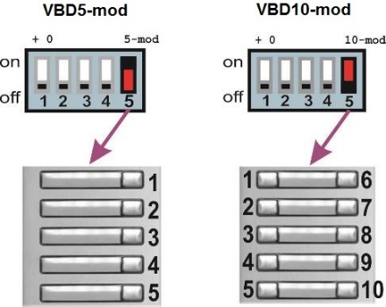
A-VarioBell analogue door entry phone
A-VarioBell modules
N3150/AL C MOD
Ordering code: 11883150C
Call buttons module, 5 single call buttons, illuminated call button labels if external power supply is used
1.8mm thick alluminium, call buttons with stainless steel cover
Steady illumination at the door panel through white leds
Easy system of numbering individual call buttons, settings by DIP switch
Up to 85 call buttons via C buttons module, maximum 87 call buttons with the main module
Universal call buttons module which can be used with analogue, GSM and SIP VoIP VarioBell doorphones
Module external dimensions: 100(w) x 100(h) mm

Slide 17
A-VarioBell analogue door entry phone
A-VarioBell modules
N3210/AL C MOD
Ordering code: 11883210C
Call buttons module, 10 call buttons (2x 5 call buttons), illuminated call button labels if external power supply is used
Module external dimensions: 100(w) x 100(h) mm
Steady illumination at the door panel through white leds
1.8mm thick alluminium, call buttons with stainless steel cover
Easy system of numbering individual call buttons, settings by DIP switch
Up to 85 call buttons via C buttons module, maximum 87 call buttons with the main module
Universal call buttons module which can be used with analogue, GSM and SIP VoIP VarioBell doorphones

Slide 18
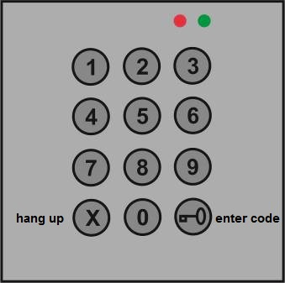
A-VarioBell analogue door entry phone
A-VarioBell modules
N3301AL ALPHA
Ordering code: 11883301A
Module external dimensions: 100(w) x 100(h) mm
Keypad module – dialling or access code
illuminated buttons if external power supply is used
1.8mm thick alluminium, call buttons with stainless steel cover
Direct dialling of phone numbers, maximum 24 digits
Dialling numbers from memory of doorphone (01-99), just a 2-digit short dial
Keypad saves extra call buttons, you can dial 2-digit speed dials from memory
Dial numbers from memory of doorphone directly, max. 99 numbers for day mode and 99 numbers for night mode

Slide 19
A-VarioBell analogue door entry phone
A-VarioBell modules
N3301 ALPHA
Ordering code: 11883301A
No special setup for keypad – automatic detection
Just connect keypad anywhere via supplied flat cable
Keypad module – during the active call you can dial DTMF
Cancel (hang up) button for cancellation and key button for entering an access code
From 10 up to 36 access codes depending on settings (day and night mode, day/night mode, etc.)
Universal keypad module which can be used with analogue, GSM and SIP VoIP VarioBell doorphones

Slide 20
A-VarioBell analogue door entry phone
A-VarioBell modules
N3002/AL
Ordering code: 11883002
Module external dimensions: 100(w) x 100(h) mm
Name / House number module
info window made of polycarbonate
Combine it with dialling keypad
Create a list of speed-dial extensions to call users

Slide 21
A-VarioBell analogue door entry phone
A-VarioBell modules
N3000/AL
Ordering code: 11883000
Module external dimensions: 100(w) x 100(h) mm
Blind module
Fill out empty space for planned expansion of the system
Later on, you can replace it by any call button module, keypad module or house number module
1.8mm thick alluminium

Slide 22
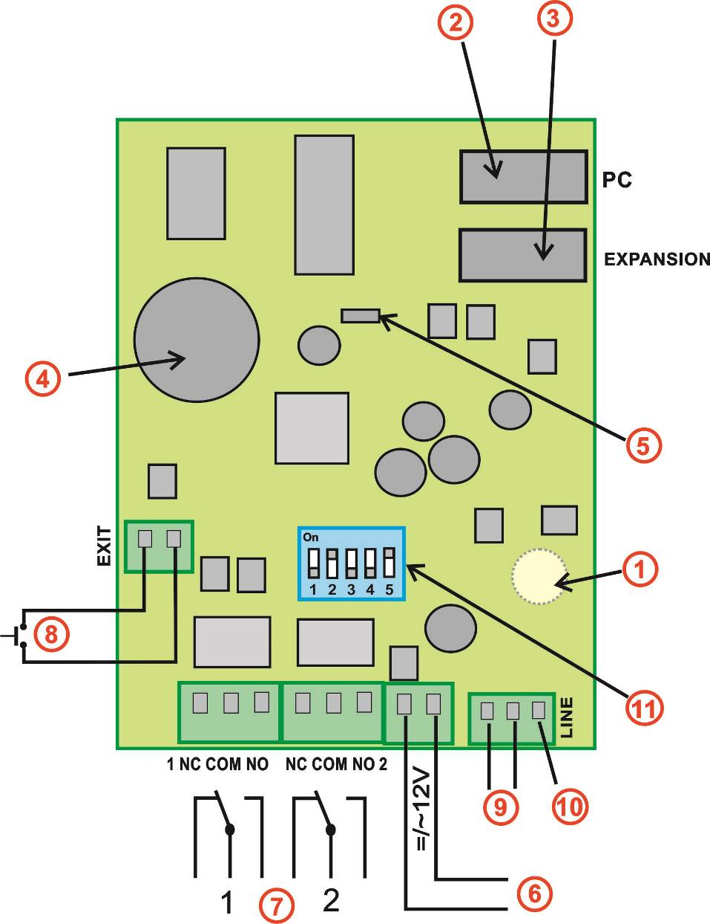
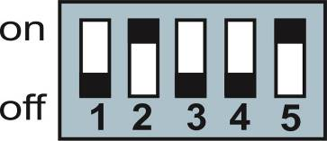
A-VarioBell analogue door entry phone
Description on the main board (PCB of the main module with 0, 1 or 2 call buttons)
1. Microphone (placed in plastic cover, output at bottom of the board)
2. PC connection connector via USB cable
3. BUS connector for connection of extending modules and keypad
4. ACCU battery for RTC (real time clock chip)
5. Speaker – output at bottom of the board. At top of the board there is a connector for connection of an external speaker
6. 12V AC/DC power supply for:
- relays control
- board heating
- name cards lighting/illumination
- external powering of the door phone (DIP 3 and 4)
- exit button circuit
- LED signalling on the front panel
7. Relays – these are galvanically isolated switchable contacts, max. 48V, max. 1,5A
At relay 1 there is available a special function of so called „code relay“ (COSW – CodeSwitch) for safe use of relay 1
8. Exit button – it works in a circuit of a current loop.
The length of connected wires to this button can be up 500m. Functionality condition = 12V power on the screw (see point 6 above)
9. Analog phone line (it does not depend on polarity)
10. Grounding – connection for grounding against static electricity – protection of the door phone electronics and also of the PBX
11. DIP switch:
1 = Service – used when password is forgotten
Incoming call is going directly to programming mode where you can setup a new password. (do not forget to return it back to off position)
2 = heating – activate integrated board heating
3 = external power supply
4 = External power supply – switching always 3 and 4 simultaneously. Powering is used from screw 12V (6) and there are 2 reasons for its use:
- using relay in mode 7 or 8 - permanent relay close/open is possible with external powering only. Do not forget to set parameter 64
- connection of the door phone to PBX extension which has troubles with current consumption after PBX start (usually Siemens PBX).
5 = name cards lighting/illumination (switch ON/OFF LED lighting/illumination for name cards)

Slide 23
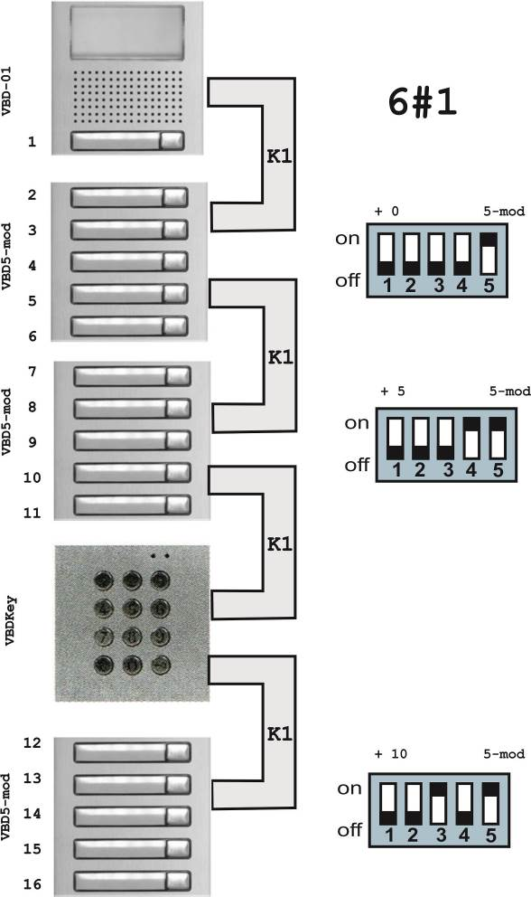
A-VarioBell analogue door entry phone
A-VarioBell example of HW configuration
First call button on the main module
The main module uses programmable parameters
For example:
6#1 (i.e. 6# = 1), it means the main module uses a single call button
Expansion modules are connected via supplied flat cables
Keypad module can be connected anywhere
Keypad position has no influence on functionality
Keypad is detected automatically
Keypad can be used for entering access codes or dialling extensins (numbers)
Numbering plan of call button modules
Set by correct setting of the DIP switch on the module

Slide 24
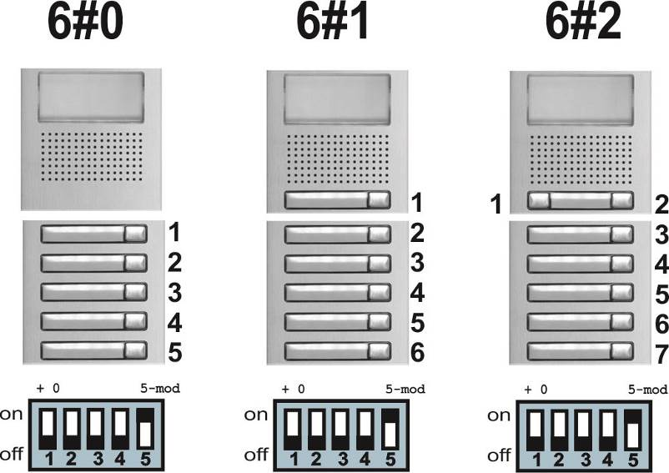
A-VarioBell analogue door entry phone
A-VarioBell examples of HW configurations
Zero, one or two call buttons on the main module
The main module uses programmable parameters
For example:
6#0 (i.e. 6# = 0), it means the main module does not use any call buttons
6#1 (i.e. 6# = 1), it means the main module uses a single call button
6#2 (i.e. 6# = 2), it means the main module uses two call buttons
Numbering plan of call button modules
Set by correct setting of the DIP switch on the module
Expansion modules are connected via supplied flat cables

Slide 25
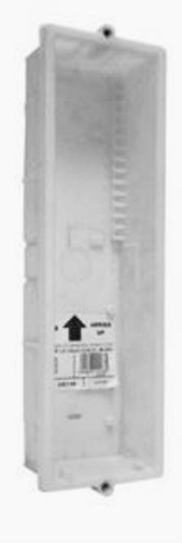
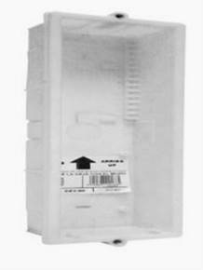
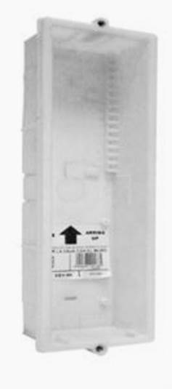
A-VarioBell analogue door entry phone
A-VarioBell flush mounting boxes for installation into the wall
NCEV-90CS
Ordering code: 11880902
Flush mounting installation box for 1 module
Embedding box for 1 vertical module
Dimensions: 99(w) x 136(h) x 40(d) mm
Assembling set for 1 module N6001/AL required

Slide 26
A-VarioBell analogue door entry phone
A-VarioBell flush mounting boxes for installation into the wall
NCEV-90C
Ordering code: 11880900
Flush mounting installation box for 2 modules
Embedding box for 2 vertical modules
Dimensions: 99(w) x 236(h) x 40(d) mm
Assembling set for 2 modules N6002/AL required

Slide 27
A-VarioBell analogue door entry phone
A-VarioBell flush mounting boxes for installation into the wall
NCEV-90
Ordering code: 11259906
Flush mounting installation box for 3 modules
Embedding box for 3 vertical modules
Dimensions: 99(w) x 328(h) x 40(d) mm
Assembling set for 3 modules N6003/AL required

Slide 28
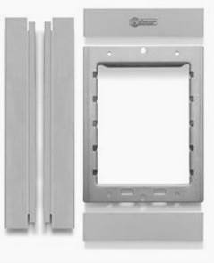
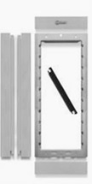
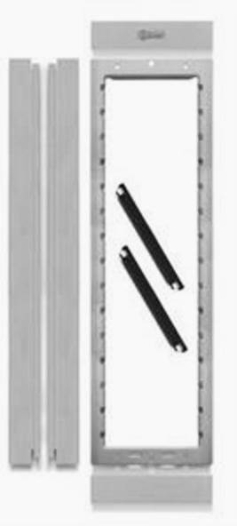
A-VarioBell analogue door entry phone
A-VarioBell frames – assembling sets, used with flush and surface boxes
N6001/AL
Ordering code: 11880601
Assembling set for 1 module
For 1 vertical module
Includes lateral profiles, fixing and design frames and closing heads
Aluminium

Slide 29
A-VarioBell analogue door entry phone
A-VarioBell frames – assembling sets, used with flush and surface boxes
N6002/AL
Ordering code: 11880602
Assembling set for 2 modules
For 2 vertical modules
Includes lateral profiles, fixing and design frames and closing heads
Aluminium

Slide 30
A-VarioBell analogue door entry phone
A-VarioBell frames – assembling sets, used with flush and surface boxes
N6003/AL
Ordering code: 11880603
Assembling set for 3 modules
For 3 vertical modules
Includes lateral profiles, fixing and design frames and closing heads
Aluminium

Slide 31
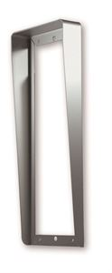
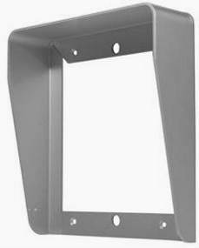
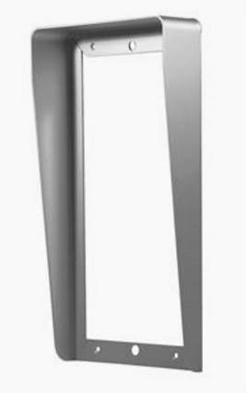
A-VarioBell analogue door entry phone
A-VarioBell rain shields – rain hoods for flush mounting installations
N711/AL
Ordering code: 11880711
Rain shield for 1 module
Rain shield for 1(H) x 1(W)
Aluminium
Dimensions: 134(w) x 156(h) x 40(d) mm

Slide 32
A-VarioBell analogue door entry phone
A-VarioBell rain shields – rain hoods for flush mounting installations
N721/AL
Ordering code: 11880721
Rain shield for 2 modules
Rain shield for 2(H) x 1(W)
Aluminium
Dimensions: 134(w) x 258(h) x 40(d) mm

Slide 33
A-VarioBell analogue door entry phone
A-VarioBell rain shields – rain hoods for flush mounting installations
N731/AL
Ordering code: 11880731
Rain shield for 3 modules
Rain shield for 3(H) x 1(W)
Aluminium
Dimensions: 134(w) x 361(h) x 40(d) mm

Slide 34
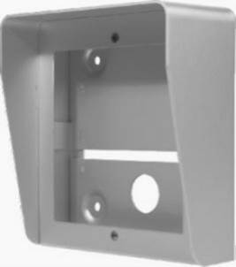
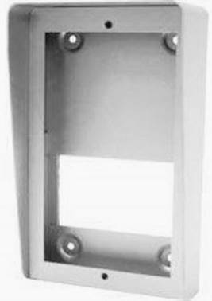
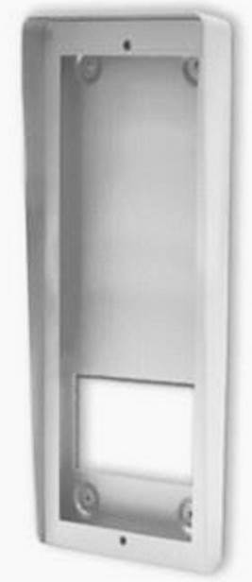
A-VarioBell analogue door entry phone
A-VarioBell surface mounting boxes with integrated rain shields
N871/AL
Ordering code: 11880871
Surface box with integrated rain shield for 1(H) x 1(W)
Aluminium
No embedding box required
Dimensions: 134(w) x 156(h) x 80(d) mm

Slide 35
A-VarioBell analogue door entry phone
A-VarioBell surface mounting boxes with integrated rain shields
N872/AL
Ordering code: 11880872
Surface box with integrated rain shield for 2(H) x 1(W)
Aluminium
No embedding box required
Dimensions: 134(w) x 258.5(h) x 80(d) mm

Slide 36
A-VarioBell analogue door entry phone
A-VarioBell surface mounting boxes with integrated rain shields
N873/AL
Ordering code: 11880873
Surface box with integrated rain shield for 3(H) x 1(W)
Aluminium
No embedding box required
Dimensions: 134(w) x 361(h) x 80(d) mm

Slide 37
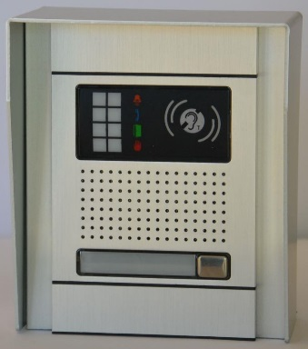
A-VarioBell analogue door entry phone
11880871
11880601
11881000A
A-VBD-S01A
=
N871/AL
N6001/AL
N1000/AL AUDIO Analog
Analog VBD S01A SINGLE
A-VarioBell example configuration
one call button, assembling set, surface mounted box with rain hood
empty black label and LEDs label are included
audio-induction loop for speaker is optional
Analog VBD S01A SINGLE (= N871/AL + N6001/AL + N1000/AL AUDIO Analog)
Ordering code: A-VBD-S01A (= 11880871 + 11880601 + 11881000A)
Surface box dimensions: 134(w) x 156(h) x 80(d) mm

Slide 38
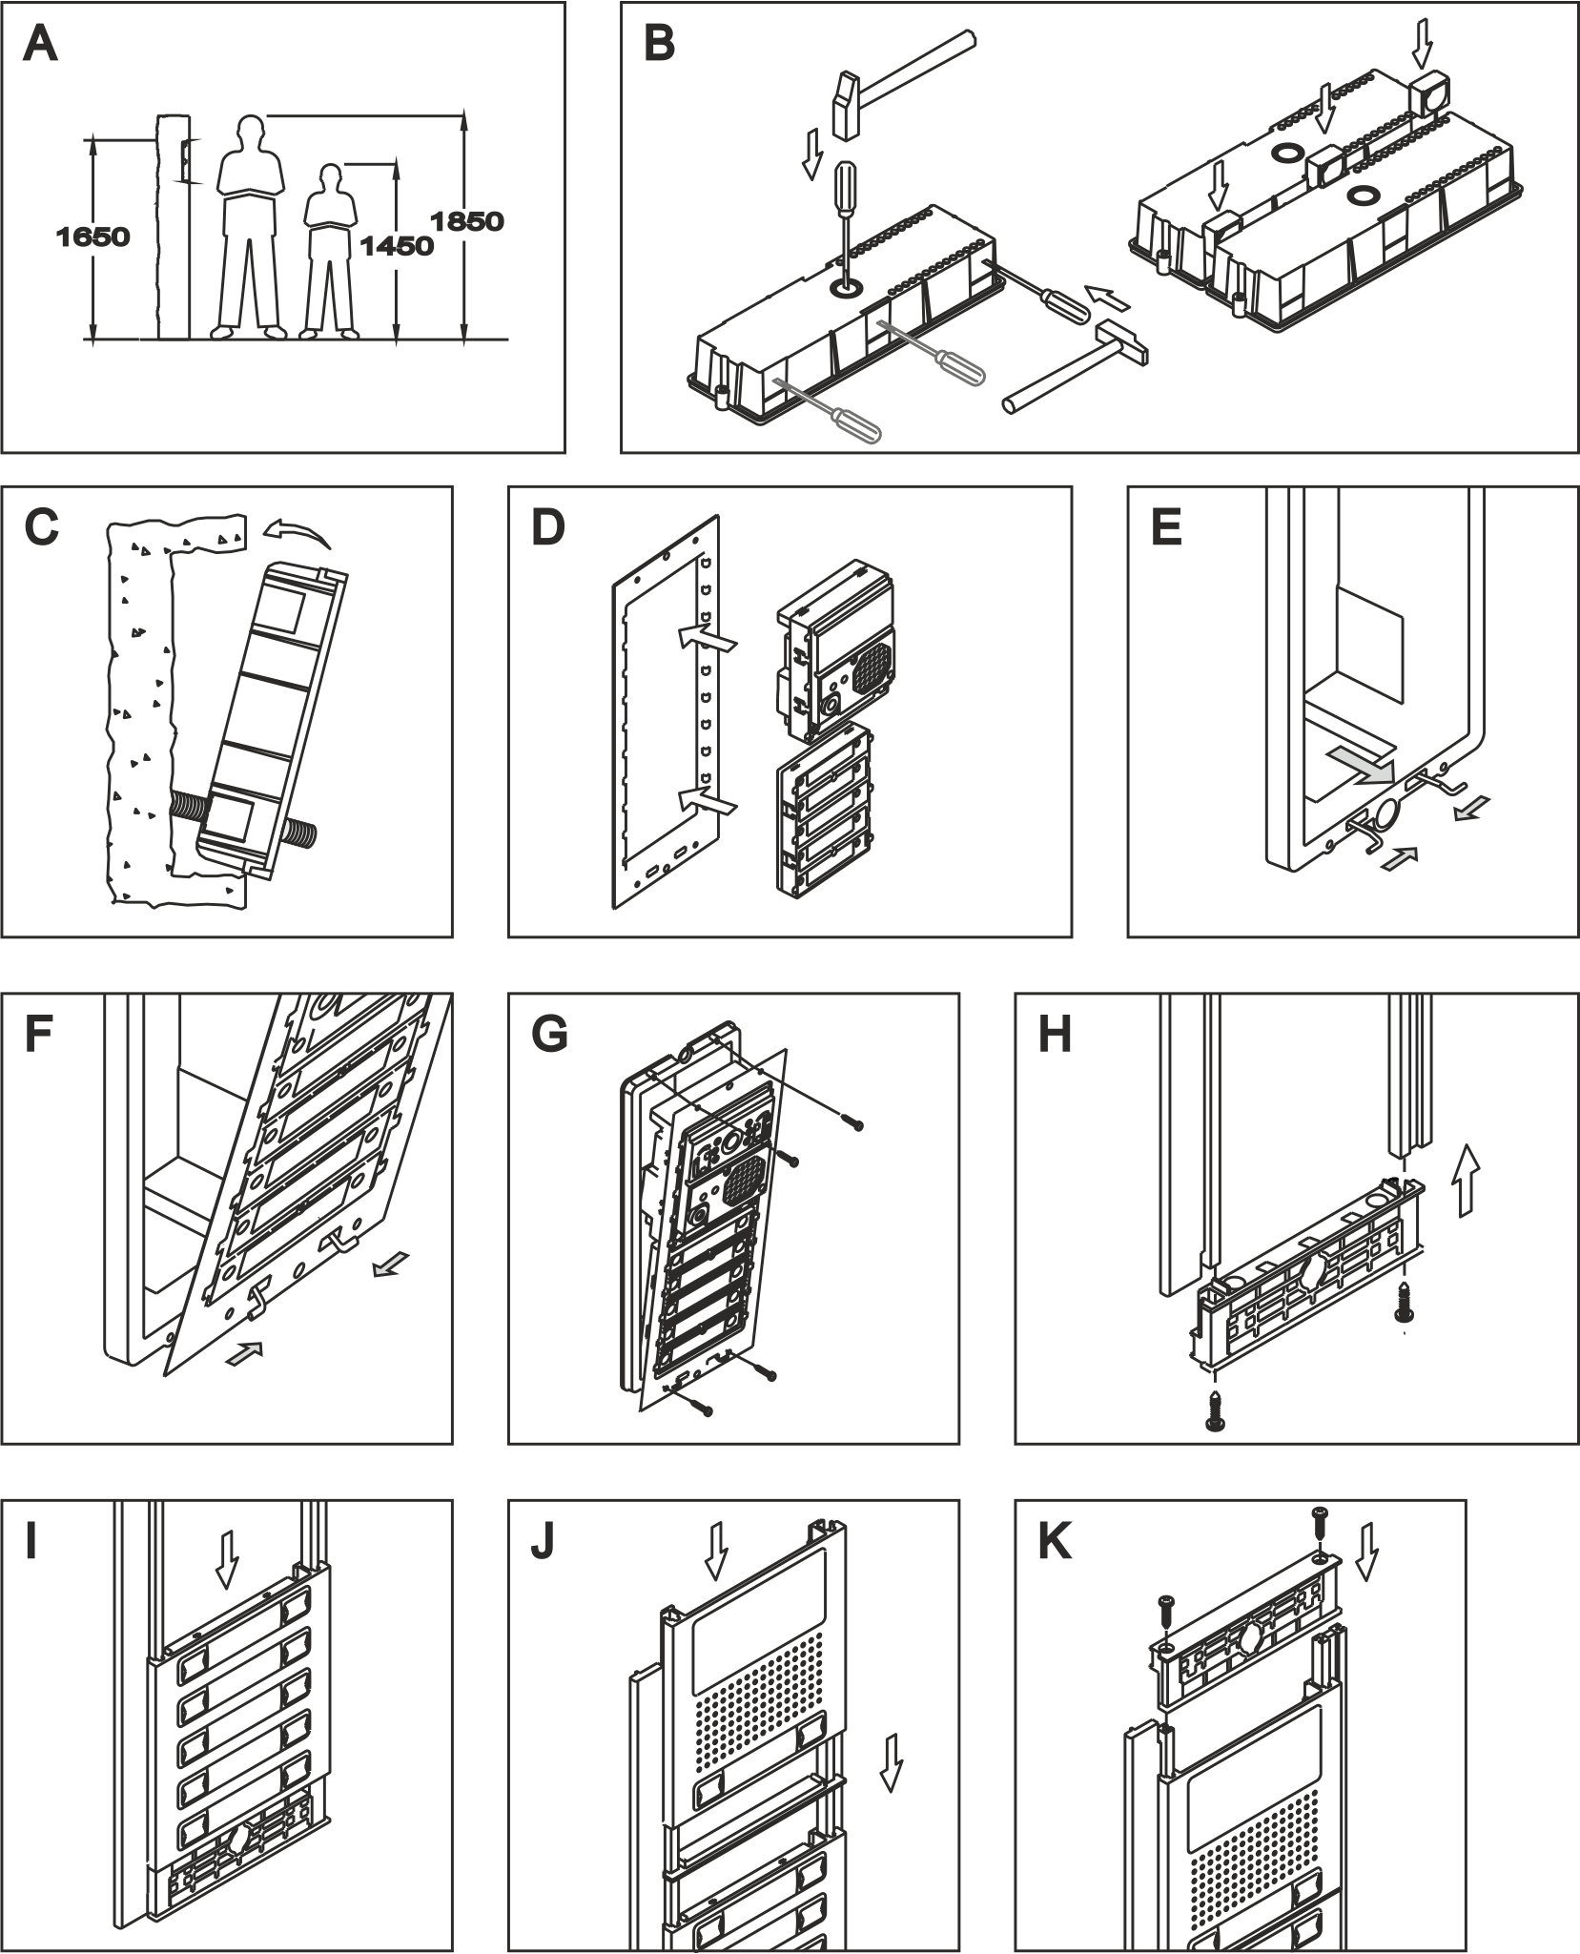
A-VarioBell analogue door entry phone
Mounting/assembly process:
Description of flush mounting into the wall, which is more complicated:
A Prepare mounting holes in the wall
Recommended height is at around 160cm from the ground
Dimension of holes for flush mounting boxes depends on required number of modules
We mention dimensions for 1, 2 and 3 modules (basic mounting boxes)
Bigger sets with more than 3 modules are completed by combining basic mounting boxes (under or next to each other)
B Prepare the flush mounting box for cables and mutual connection of flush mounting boxes
C Fix the flush mounting box into the prepared hole inside the wall
D Insert modules into the fixing frame (fixing frame is a part of assembly set)
E Insert spring to the bottom part of the flush mounting box
F Insert fixing frame into the spring in the flush mounting box
G Install the fixing frame to the flush mounting box with 4 screws (screws are supplied – part of delivery)
H Complete the design frame (part of assembly set) – firstly use screws to assemble the side rails with the bottom part
I Insert the front panels into the design frame according to the individual modules used in the configuration
J The last module (the module on the top) slides into the design frame
K In the end use screws to assemble the top part to the design frame (into the side rails)
L Such a completed set as shown on pictures H+I+J+K is ready for installation into the flush mounting box
M The last step is to insert covers on the design frame
Modules | 1 | 2 | 3
Height mm | 140 | 257 | 374
Width mm | 125 | 125 | 125
Depth mm | 56 | 56 | 56

Slide 39
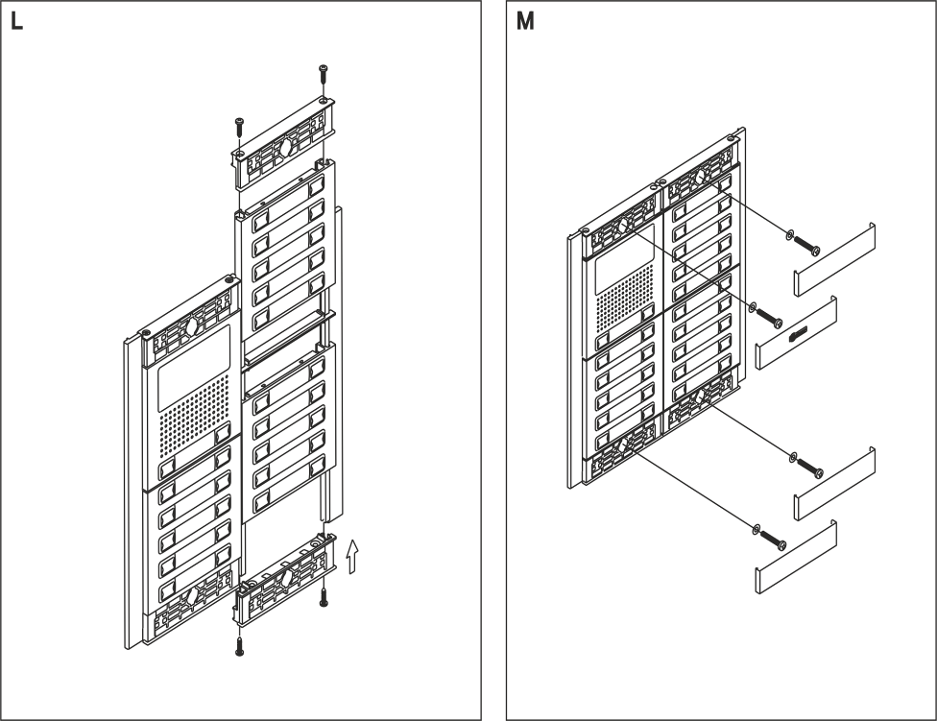
A-VarioBell analogue door entry phone
Mounting/assembly process:
Description of flush mounting into the wall, which is more complicated:
A Prepare mounting holes in the wall
Recommended height is at around 160cm from the ground
Dimension of holes for flush mounting boxes depends on required number of modules
We mention dimensions for 1, 2 and 3 modules (basic mounting boxes)
Bigger sets with more than 3 modules are completed by combining basic mounting boxes (under or next to each other)
B Prepare the flush mounting box for cables and mutual connection of flush mounting boxes
C Fix the flush mounting box into the prepared hole inside the wall
D Insert modules into the fixing frame (fixing frame is a part of assembly set)
E Insert spring to the bottom part of the flush mounting box
F Insert fixing frame into the spring in the flush mounting box
G Install the fixing frame to the flush mounting box with 4 screws (screws are supplied – part of delivery)
H Complete the design frame (part of assembly set) – firstly use screws to assemble the side rails with the bottom part
I Insert the front panels into the design frame according to the individual modules used in the configuration
J The last module (the module on the top) slides into the design frame
K In the end use screws to assemble the top part to the design frame (into the side rails)
L Such a completed set as shown on pictures H+I+J+K is ready for installation into the flush mounting box
M The last step is to insert covers on the design frame
Modules | 1 | 2 | 3
Height mm | 140 | 257 | 374
Width mm | 125 | 125 | 125
Depth mm | 56 | 56 | 56

Slide 40
A-VarioBell analogue door entry phone
item | Dimension HxWxD [mm]
 | 1 module | 2 modules | 3 modules | 2 x 3 modules
Module | 100 x 100
Flush mounting box into the wall | 136x99x56 | 244x99x56 | 328x99x56 | -
Fixing frame (part of assembly set) | 173x128 | 256x128 | 358x128 | -
Design frame (part of assembly set) | 278x200 | 430x200 | 512x200 | 512x334
Rain shield for flush mounting | 156x134x40 | 258x134x40 | 361x134x40 | 361x234x40
Surface mounting box | 156x134x80 | 258x134x80 | 361x134x80 | 361x234x80

Slide 41
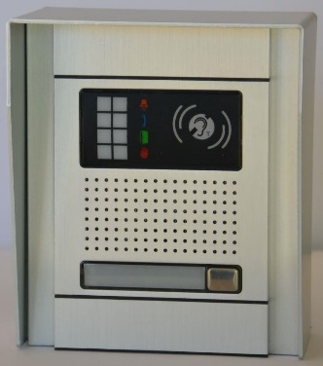
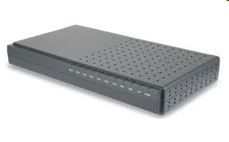
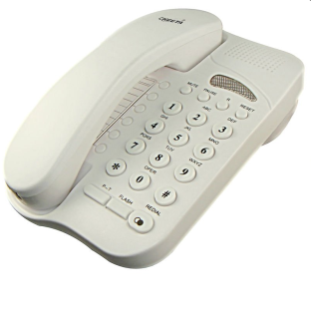
A-VarioBell analogue door entry phone
PBX
The A-VarioBell can be connected to the phone line of telephone system (PBX) as well as to the standard analog phone (PSTN, land line).
analog phone line

Slide 42
A-VarioBell analogue door entry phone
2 relays / 8 modes for gates, doors etc.
Call buttons or keypad can be used for a code lock
Controling relay during active call via DTMF
Optional security relay function „COSW-CodeSwitch“ for the first relay. When using this function it is not possible just by connecting or disconnecting the power supply to activate the lock and open the door or gate. Activation is performed only when there is a compliance of serial information transmitted between the A-VarioBell and the optional COSW board.

Slide 43
A-VarioBell analogue door entry phone
The A-VarioBell behaves as a regular analog phone – it is powered from the telephone line and does not require external power.
PBX
analog phone line
When using electric locks, the A-VarioBell requires an external power supply. In this case the A-VarioBell is powered from this source - it does not need permanent voltage on the telephone line.
power supply 12V

Slide 44
A-VarioBell analogue door entry phone
The A-VarioBell example connections of relay contacts
power supply 12V

Slide 45
A-VarioBell analogue door entry phone
The A-VarioBell secure connection of the 1st relay contact
Optional security relay function „COSW-CodeSwitch“ for the first relay. When using this function it is not possible just by connecting or disconnecting the power supply to activate the lock and open the door or gate. Activation is performed only when there is a compliance of serial information transmitted between the A-VarioBell and the COSW board (optional item).

Slide 46
A-VarioBell analogue door entry phone
All parameters of the A-VarioBell can be configured:
PBX
analog phone line
USB cable
By program from PC
During a call via DTMF dialling

Slide 47
VarioBell family
Analog - GSM - SIP VoIP audio-video
Maximum variability – minimum stock requirements - choose analog, GSM or IP main modules only, all other modules and parts are the same for all 3 systems

